Slide 1
Module 1 : Parallelism Fundamentals

Slide 2
Motivation
With respect to both hardware and software,
Road blocks to improve performance with serial code / single uni-core systems
Hardware has to support parallelism for improved performance
Software has to be able to offer parallelism (in terms of codes, compilers etc)

Slide 3
Key Concepts

Slide 4
What is parallelism?
Parallelism is the process of executing multiple
Instructions on same data or single instruction on multiple data or a combination of both
Is parallelism and concurrency the same?
Concurrency does not need redundant units while parallel computing involves redundant structures

Slide 5
Why Parallelism?
It is the obvious choice of high performance evolution
A learning from applications
Concurrency and parallelism is key to future systems

Slide 6
Why Parallel, Concurrent and Distributed Computing?
Parallel computing can transform science and engineering
Example: Cosmology - the study of the universe
Its evolution and structure—where one of the most striking paradigm shifts has occurred. A number of new, tremendously detailed observations deep into the universe are available from such instruments as the Hubble Space Telescope and the Digital Sky Survey. However, until recently, it has been difficult, except in relatively simple circumstances, to use mathematical theories of the early universe to allow comparison with observations.
Scalable parallel computers with large memories have changed all of that

Slide 7
To port or not to port?
That should not suffix (porting)
Write parallel applications for parallel architectures should involve reformulating data structures, basic code and the dynamics involved

Slide 8
Parallel supercomputing can answer challenges to society
Parallel computing that not only involves particle studies but for human related data
Health care
Weather / environmental application

Slide 9
The burden is not on the ‘Hardware’ alone
Even with existing architecture, there are lot of ways the parallelism can be adapted to harness efficiency in terms of execution time, power and so on

Slide 10
Overview of Parallel Computing, Architectural Demands and Trends

Slide 11
Evolution of Parallel architecture
Stored Program Concept
ILP (Pipelining) (SISD)
TLP
OOP (Out-of Order Processors)
Vector Processors (SIMD)
Simultaneous Multi-Threading (SMT)
Multi-core Processors (MIMD)
SIMT Architectures (GPU)
Multi-node systems (With multiple cores, GPUetc) →Distributed

Slide 12
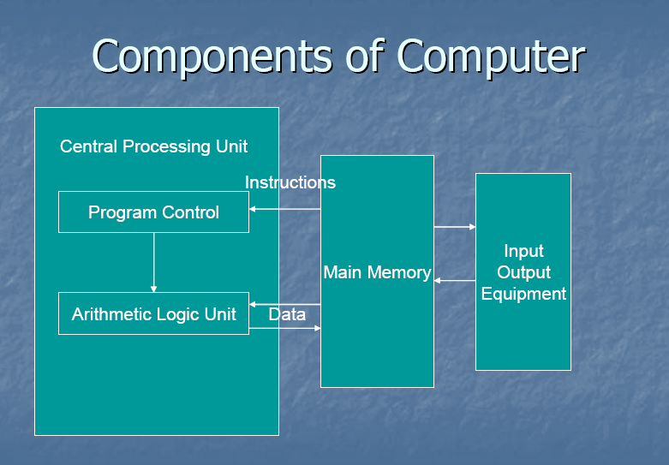
Stored Program Computers

Slide 13
CPU Fundamentals
Primary function is to execute Instructions
Program Execution Steps
CPU transfers instructions and i/p data from main memory to registers in the CPU
CPU executes instruction in their stored sequence (unless altered explicitly)
CPU transfers o/p data from CPU registers to main memory

Slide 14
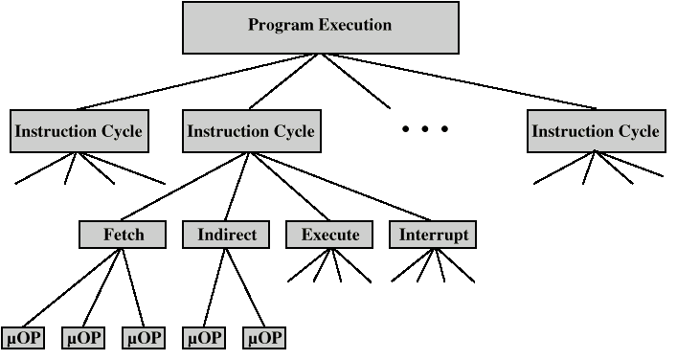
Program Execution

Slide 15
Single Core Processors

Slide 16
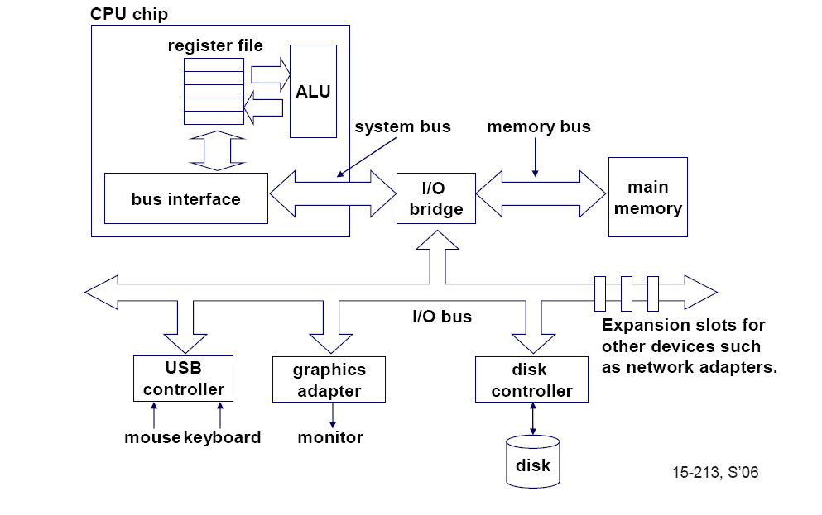
Single-core computer

Slide 17
Un-pipelined Data Path

Slide 18
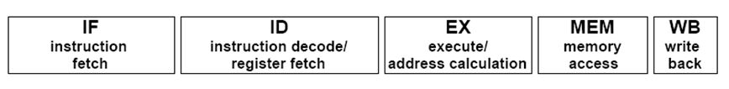
Single Processor Core
Two Parts : Control Unit and Data Path
Data Path
Control Unit
Unit to control the Data path

Slide 19
Pipelining

Slide 20
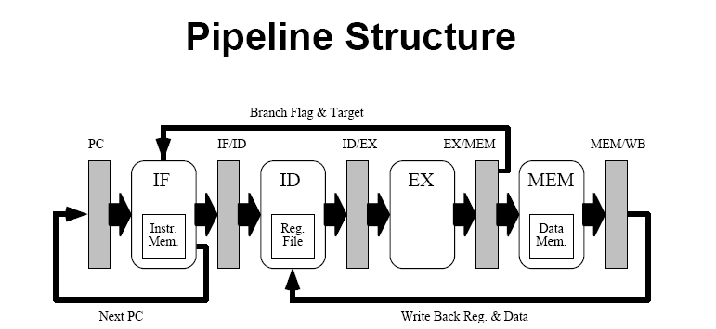
Pipelined Data-path
Include Registers in between to provide ILP (hardware support)

Slide 21
Pipeline Hazards
Structural Hazards
Data Hazards
Control Hazards

Slide 23
Pipeline Hazards & Solutions
Structural Hazards
Redundancy
Data Hazards
Forwarding, Loop Unrolling
Control Hazards
Branch Prediction

Slide 24
Constraints in In-order Execution
Data Hazard
DIV.D F0,F2,F4
ADD.D F6,F0,F8
SUB.D F1,F3,F5
MUL.D F6,F10,F8
Structural Hazard
DIV.D F0,F2,F4
DIV.D F1,F3,F5
ADD.D F7,F9,F11
SUB.D F8,F10,F14
MUL.D F6,F10,F8

Slide 25
…Continued
Control Hazard
Beq F0,F2, S1
DIV.D F1,F3,F5
ADD.D F6,F0,F8
Jmp S2
S1: SUB.D F8,F10,F14
S2: MUL.D F7,F11,F9

Slide 26
Pipelined Processor with Out of Order Execution
The fundamental problem we face when trying to keep four functional units busy is that it's difficult to find contiguous sets of instructions that can be executed in parallel.
The solution to these problems is out-of-order execution and speculative execution.
Support by both hardware and software
Hardware that allows instruction execution out of order
Software to allow totally independent instructions to be fetched

Slide 27
Drawback of In Order Execution
A major limitation of in order execution is
Stalling the execution pipeline till all the previous instructions are issued irrespective of its data dependency
Eg:
DIV.D F0,F2,F4
ADD.D F10,F0,F8
SUB.D F12,F8,F14

Slide 28
The Idea of Out of Order Execution
In the previous example, to issue SUB.D, we must separate issue into two parts:
Checking for any structural hazard
Waiting for the absence of data hazard
We still use in-order instruction issue, but we want an instruction to begin execution as soon as operands are available which implies Out Of Order Completion

Slide 29
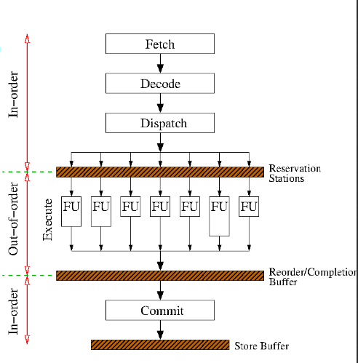

Slide 30
DIV F0, F1, F2
MUL F4, F2, F3
ADD F5, F0, F4
SUB F5, F2, F1
ShiftL F1, F6, F7

Slide 31
Continued…
Out of order execution introduces the possibility of WAR and WAW hazards which do not exist in the 5-stage pipeline
Eg:
DIV.D F0,F2,F4
ADD.D F6,F0,F8
SUB.D F8,F10,F14
MUL.D F6,F10,F8
WAR Hazard between ADD.D and SUB.D
WAW Hazard between ADD.D and MUL.D

Slide 32
Out-of-Order Completion Complexities
Exceptions should be preserved and imprecise exceptions should not arise.
Imprecise exceptions can occur because of two possibilities
The pipeline may have already completed instructions that are later in program order than the instruction causing exception
The pipeline may have not completed some instructions that are earlier in program order than the instruction causing the exception

Slide 33
Out – of Order Execution
It requires multiple functional units or pipelined functional units or both.
In a dynamically scheduled pipeline, all instructions pass through the issue stage in order
However, they can be stalled or bypass each other in the read operand stage.
Score-Boarding is a technique for allowing instructions out of order execution when there are sufficient resources and data dependences.
Tomasulo’s Algorithm: handles anti-dependences and output dependences by effectively renaming the registers dynamically.

Slide 34
Evolution of Multi-Core

Slide 35
Era before Multi-Core
Improved hardware technologies resulted in,
Increased clock frequency
Increased transistor density
Exploiting ILP

Slide 36
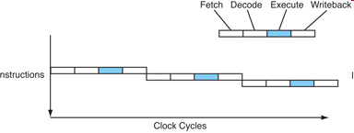
What is Instruction Level Parallelism?

Slide 37
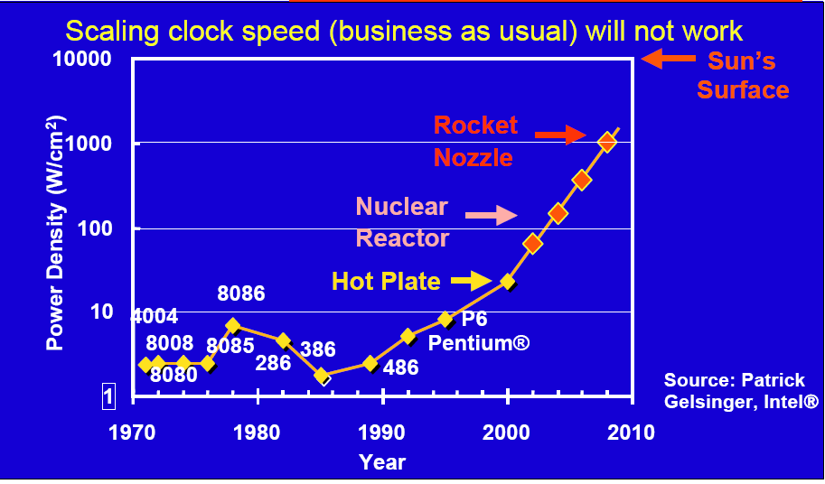
Power Wall
Can put more transistors on a chip than afford to turn on

Slide 38
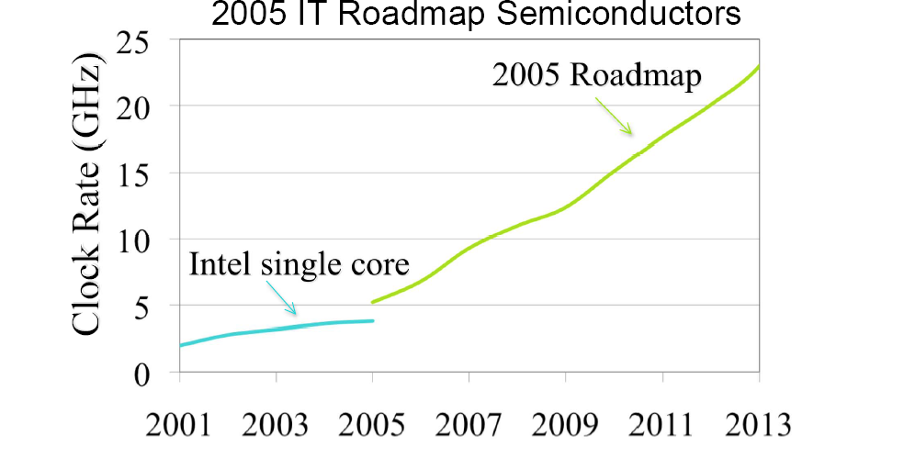
Frequency Wall
Dynamic power in a chip is proportional to V²fC
So increasing ‘f’ will lead to power wall.

Slide 39
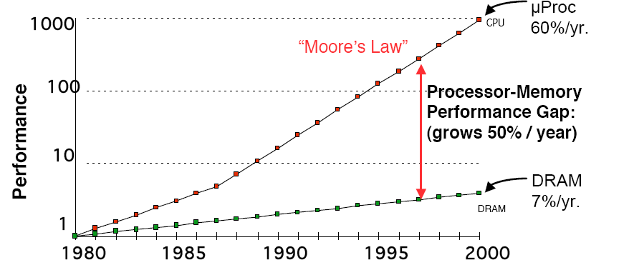
Memory Wall

Slide 40
What’s the Solution?
Because of the above discussed walls, performance can no more be benefitted from ILP or by increasing frequency
Improved Thread level Parallelism will provide the solution
Software level threads were developed to increase number of threads

Slide 41
Software Solution to Improve ILP

Slide 42
Concurrent Execution Model
More complex computing systems allow a user to run multiple applications that execute at the same time.

Slide 43
Sequential Execution
Conventional programs are called sequential because a programmer imagines a computer executing the code statement by statement
At any instant, the machine is executing exactly one statement

Slide 44
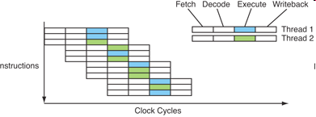
Thread Level Parallelism – Increasing Hardware Threads

Slide 45
How TLP overcomes the barriers?
Overcoming Power wall & Frequency wall
A single processor operating at 4 GHz can be replaced by a multiple processor each operating at 2 GHz.
Overcoming Memory Wall
Multithreading means cycle-by-cycle interleaving of instructions from different processes.
If one process is busy with memory, that latency can be masked by executing other threads.

Slide 46
Why not Multi-Processors?
Communication latency between processors on different boards are high.
This will become a bottle neck for performance.

Slide 47
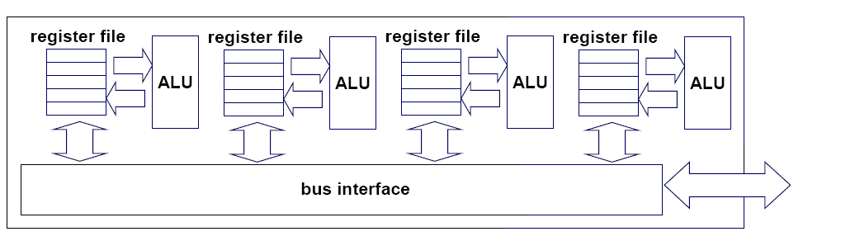
What is Multi-Core?

Slide 48
Moore’s law : Alive & Well
Gordon Moore (co-founder of Intel) predicted in 1965 that the transistor density of semiconductor chips would double roughly every 18 months.

Slide 49
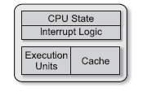
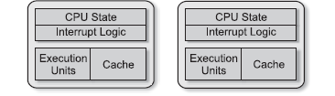
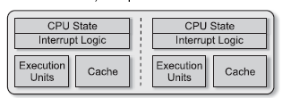
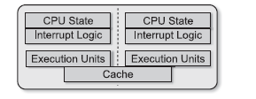
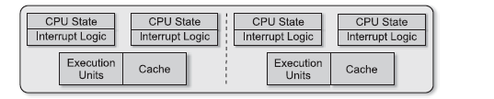
Comparison of different architectures
Single Core
Multiprocessor
Multi-core processor
Multi-core processor with shared cache
Multi-core processor with distributed cache

Slide 50
Goals of Parallelism

Slide 51
What are the Goals of parallelism?
To make the architectural design scalable
To have improved performance
To Balance cost- performance and reliability

Slide 52
Have these goals been achieved with multi-core?
To certain extent
The applications are unable to exploit the parallelism available in the multi-core processors
This has to be addressed

Slide 53
Challenges
To utilize the existing parallel architectures thoroughly
Skilled people to write parallel programs
To develop tools and libraries for parallel programming support
To scale the existing systems to perform better for the future
Architectural models to cater to fast and big data computing

Slide 54
Future Architectures
Future architectures will emphasis not only on the processors but also on
I/O devices
Memory
Interconnection among nodes

Slide 55
Communication and Co-ordination

Slide 56
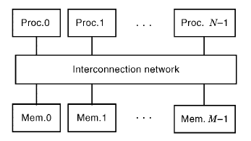
INTERCONNECTION NETWORKS FOR PARALLEL COMPUTERS
Physically Shared Memory

Slide 57
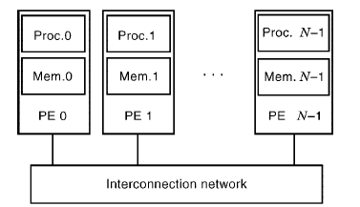
Distributed Memory

Slide 58
Network Topologies
Direct Networks
Direct networks consist of physical interconnection links that connect the nodes (typically PEs) in a parallel computer
Each node may need a router to make routing decisions.
Ring
Mesh

Slide 59
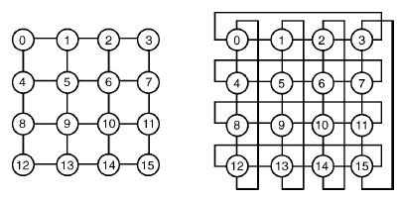
Continued…
Mesh Torus

Slide 60
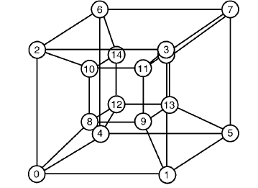
Continued…
Hypercube network

Slide 61
Continued…
Indirect Networks
In indirect networks, each processing node is connected to a network of switches over one or more (often bidirectional) links.
Typically, this network consists of one or more stages of switch boxes

Slide 62
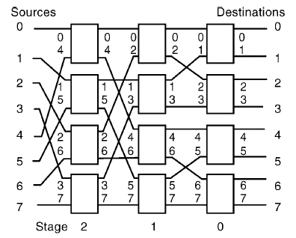

Slide 63
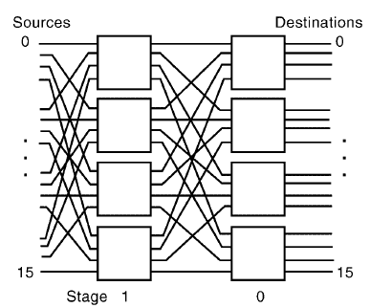

Slide 64
double arraySum = 7;
for (int i = 0; i < 100; i++) {
arraySum += A[i];
printf(arraySum)
}
arraySum=7
for (i=0 ; i<100;i<100;i=i+3)
{
arraySum+=a[i] (4 clk)
arraySum+=a[i+1] (
arraySum+=a[i+2];
}

Slide 65
loop3:
load $f10, 0($5) ; $f10 ← A[i]
add $f8, $f8, $f10 ; $f8 ← $f8 + A[i]
addi $5, $5, 8 ; increment ptr for A[i]
addi $7, $7, -1 ; decrement loop count
test:
bgtz $7, loop3 ; Continue if count > 0

